Slide 1
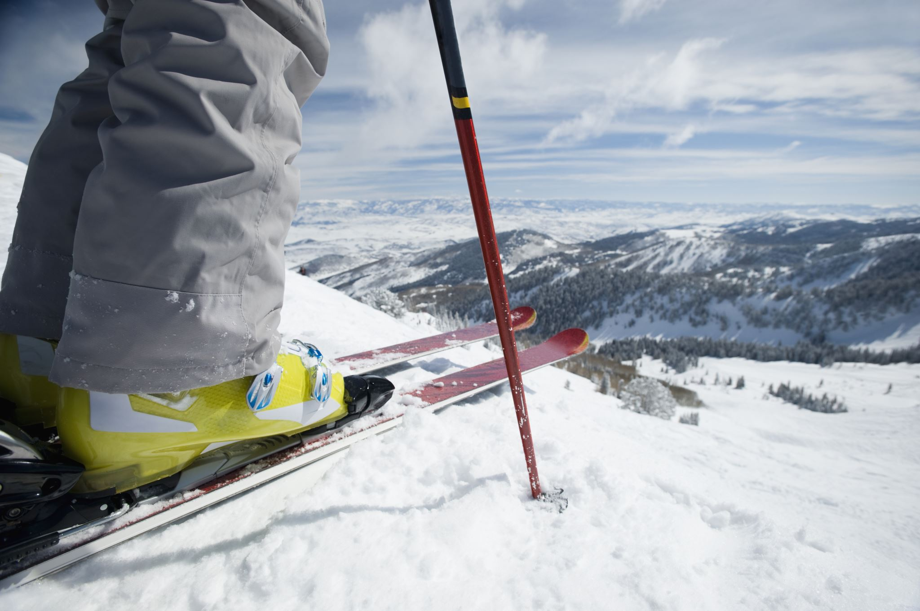
Big Mountain Resort
Marcelo Pereira
Oct/2021

Slide 2
Big Mountain Resort
Does Big Mountain Resort’s price strategy support any increase to cover the maintenance expenses of a new chair lift? Increasing the ticket price by $2 yields a projected earnings enough to cover the new expense and to create extra revenue.
4. Constraints within solution space
Weather restrictions during the season (closed access roads, storms, snow precipitation below average)
Competitors in the same area reducing their tickets to capture BMR clients
5. Stakeholders to provide key insight
CEO, Sales VP, Marketing VP, CTO, Database Manager, Head of Data Science
6. Key data sources
Data about the competitors in the market
Revenue data
Weather forecasting
1. Context
Big Mountain Resort (BMR) is a ski resort located in Montana with spectacular views of Glacier National Park and Flathead National Forest, with 105 trails. BMR has around 350K visitors yearly. Recently was installed a new chair, creating an additional operational cost of $1.5MM. We propose an increase of $2 for the ticket price to cover the operational cost of the new lift and generate extra revenue.
2. Criteria for success
Cover the $1.5MM operational cost added by the new lift
3. Scope of solution space
Increase the ticket price
Keep the 350K visitors during the season
Bonus: creation of extra revenue
Maintain the regular facilities operations
Notes:
Your client is Big Mountain Resort, a ski resort located in Montana. Big Mountain Resort
offers spectacular views of Glacier National Park and Flathead National Forest, with
access to 105 trails. Every year about 350,000 people ski or snowboard at Big Mountain.
This mountain can accommodate skiers and riders of all levels and abilities.
These are serviced by 11 lifts, 2 T-bars, and 1 magic carpet for novice skiers. The
longest run is named Hellfire and is 3.3 miles in length. The base elevation is 4,464 ft,
and the summit is 6,817 ft with a vertical drop of 2,353 ft.
Big Mountain Resort has recently installed an additional chair lift to help increase the
distribution of visitors across the mountain. This additional chair increases their
operating costs by $1,540,000 this season.
The resort's pricing strategy has been to charge a premium above the average price of
resorts in its market segment. They know there are limitations to this approach. There's
a suspicion that Big Mountain is not capitalizing on its facilities as much as it could.
Basing their pricing on just the market average does not provide the business with a
good sense of how important some facilities are compared to others. This hampers
investment strategy. You are part of a new data science team brought in to implement a
more data-driven business strategy. The business wants some guidance on how to
select a better value for their ticket price. They are also considering a number of
changes that they hope will either cut costs without undermining the ticket price or will
support an even higher ticket price.
Review the last paragraph of the overview and generate ideas about how to
increase revenue for the resort. Once you have an idea or two, use the data overview
provided below to determine if your idea can be evaluated and supported by these data.
Keep in mind that this data contains information from 330 resorts in the US that can be
considered part of the same market share and we have these same data columns for
Big Mountain Resort as well.
Region
Vertical drop / LongestRun / Skiable area / Average Snowfall / NightSkiing
Chairs
Runs (trails)
Terrain parks
Hypothesis: Create a Hypothesis with an emphasis on SMART principles. (S – Specific, M – Measurable, A – Achievable, R – Realistic, T – Timebound). If you cannot do this, you do not have a good grasp on the business problem.
Context: With context, we have clearly identified the problem at hand and have elucidated on how our initiative may solve this problem, alongside the commercial implications this will have on the business.
Criteria for Success: Clearly defining the criteria for success ensures that the scope of your work is clearly defined and understood. Otherwise, if this isn’t defined – your work will never end which will result in mismatched expectations.
Scope of Solution Space: Scoping out the solution space ensures that the business initiative is SPECIFIC for a certain segment or area. This prevents solutions that have been developed being scaled and applied for all other business units that the solution may not be responsible or scalable for.
Constraints within Solution Space: Looking forward, what are the foreseeable problems we are likely to encounter? Could this be stakeholder resistance? Could this be we don’t have access to the right data?
Stakeholders to provide key insight: Who are the people I need to speak to, to get the answers I need for my data analysis?
What key data sources are required?

Slide 3
Modeling
Data treatment
Models:
Missing data imputation: median
Training set:
70%
Testing set:
30%
Random forest best model
Average price prediction error in test set +/- $9.54 (best)
n_estimators = 54
Linear regression best model
Average price prediction error in test set +/- $11.79
8 features
Dummy model – mean
Average price prediction error in test set +/- $19.13

Slide 4
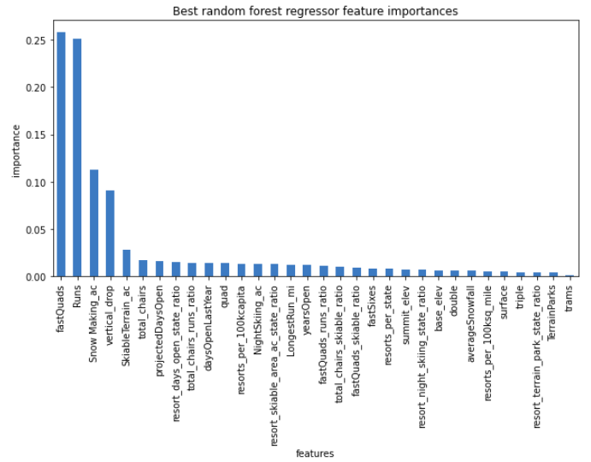
Ski Resort features importance in the model
Features used by the model to predict ticket price
fast quads
number of runs
snow making acres
vertical drop
skiable area

Slide 5
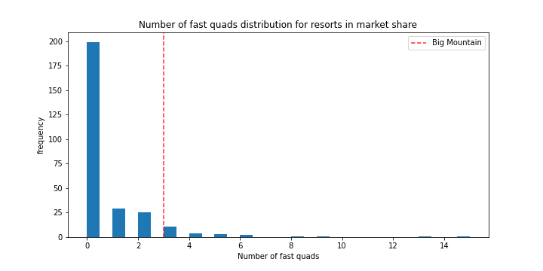
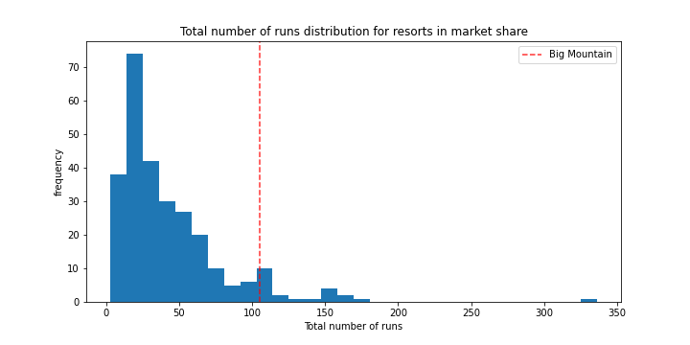
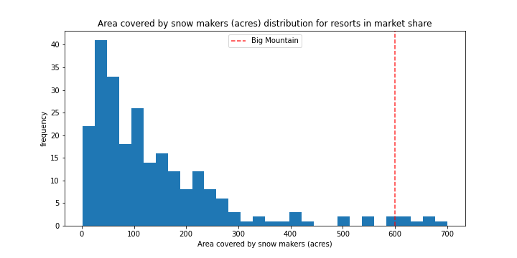
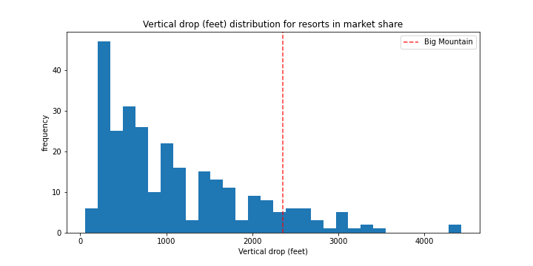
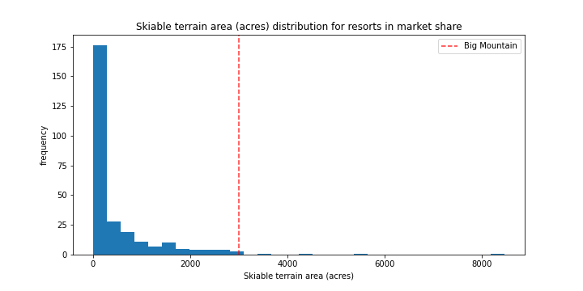
Big Mountain’s features vs. competitors
Position of BMR compared to competitors for the relevant features of the model. Is feasible to charge more?
Fast quads: 3 Runs: 105 Area Covered by Snow Makers: 600 acres
Drop: 2,353 ft Skiable terrain Big: 3,000 acres

Slide 6
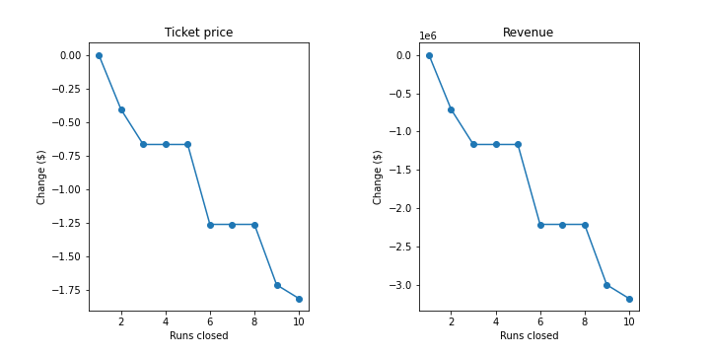
Scenarios simulation
Evaluation of the impact of closing ski runs on ticket price
Ticket price change proposed by the model
Closing 1 run
no change
Closing 2 runs
< -$0.50
Closing 3-5 runs plateaus
< -$0.75
Closing 6-8 runs plateaus
< -$1.25

Slide 7
Summary and conclusion
An increase of the price from $81 to $96 is supported by the resort facilities configuration compare do competitors
Considerations
Conclusion and alternatives
Current price is $81, and the model suggests that a change of (+/- $10) will not affect ticket sales
Ticket price of $96 is justified by BMR position in the key features for the price modeling
New price generates $3.5M revenue, covering the $1.54M extra lift operation costs
Boost vertical drop by 150ft
Allows an additional $1.99/ticket value
Increasing longest run length is revenue
Neutral by model
Requires additional snowmaking that does not add perceived market value and increases operational cost
Closing 10 least-used runs reduces modeled
Drops ticket price by $1.81
It is possible to test this solution by closing some runs and evaluating the impact
Current ticket price is undervalued, so increasing the ticket price is the expected decision

Slide 8
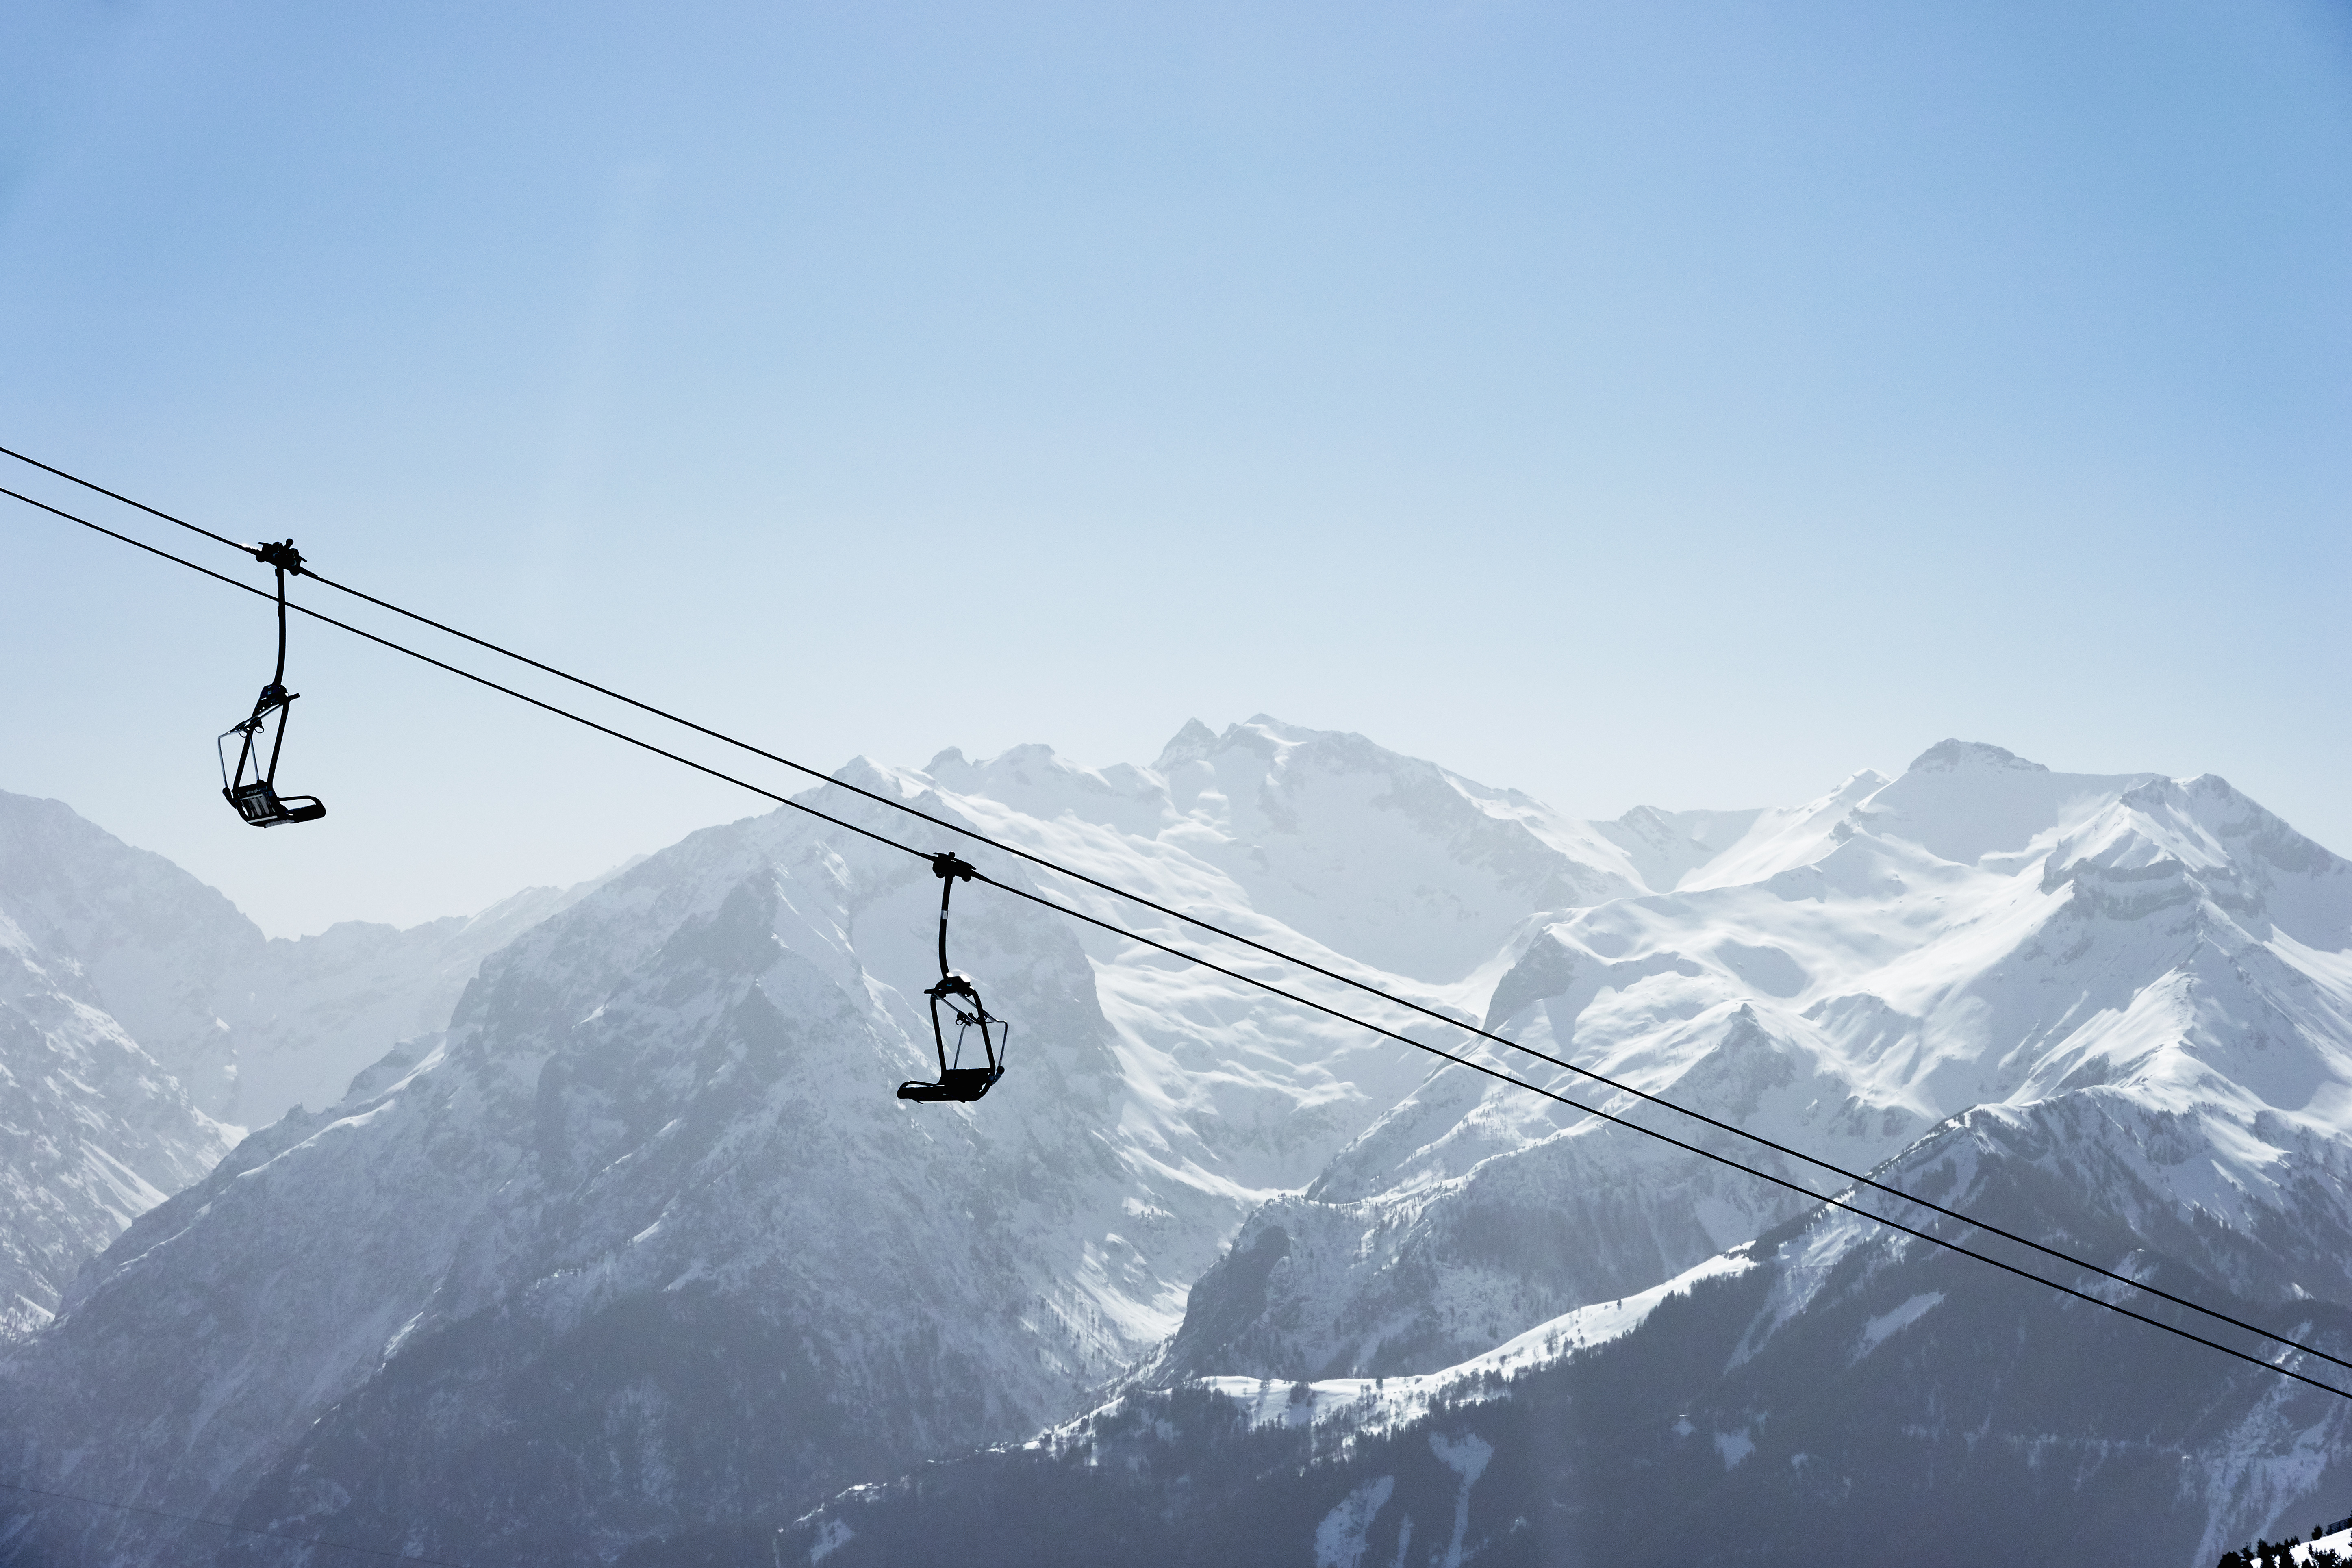



Contact:
Marcelo Pereira
https://www.linkedin.com/in/marcelo-alves-pereira/
map_fm@yahoo.com

